Slide 1
Understanding and calculating the range
Numerical summaries of data

Slide 2
how to use Oak lessons

Slide 3
I can understand what the range is measuring, how it is measuring it and calculate the range from data presented in a range of different ways.

Slide 4
range
spread/dispersion

Slide 5
The range is a measure of spread. It is found by finding the difference between the two extreme points; the lowest and highest values.
The spread/dispersion of data values is how varied they are.

Slide 6

Understanding and calculating the range
What is the range?
Extreme values in different representations

Slide 7
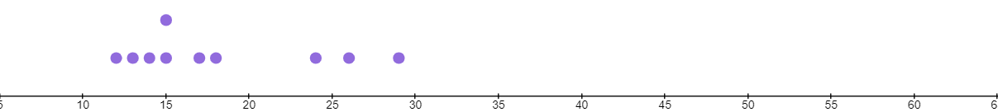
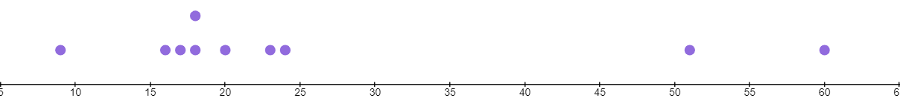
What is the range?
Which dot plot shows more spread out data?
a)
b is more spread out
b)

Slide 8
What is the range?
Which data set is more spread out?
a)
5, 12, 12, 19, 25, 28, 33, 39, 47, 53, 87, 960
b)
15, 16, 19, 19, 26, 27, 34, 34, 37, 38, 49, 57, 81, 96
a is more spread out

Slide 9
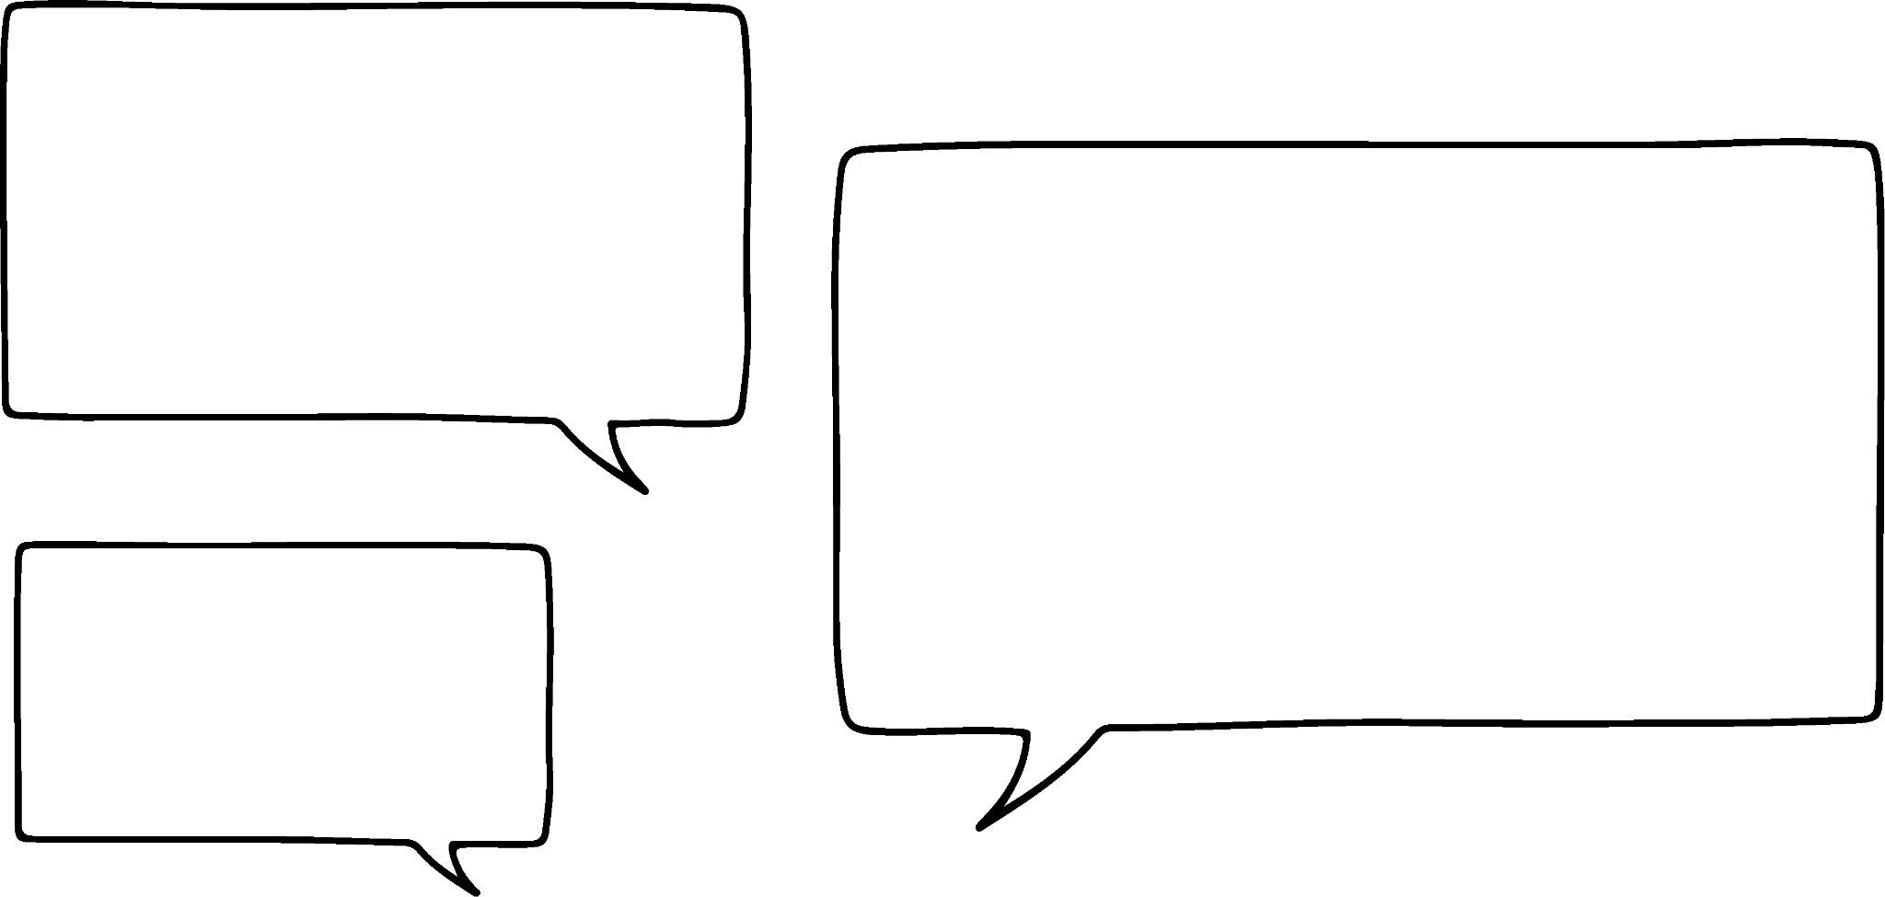
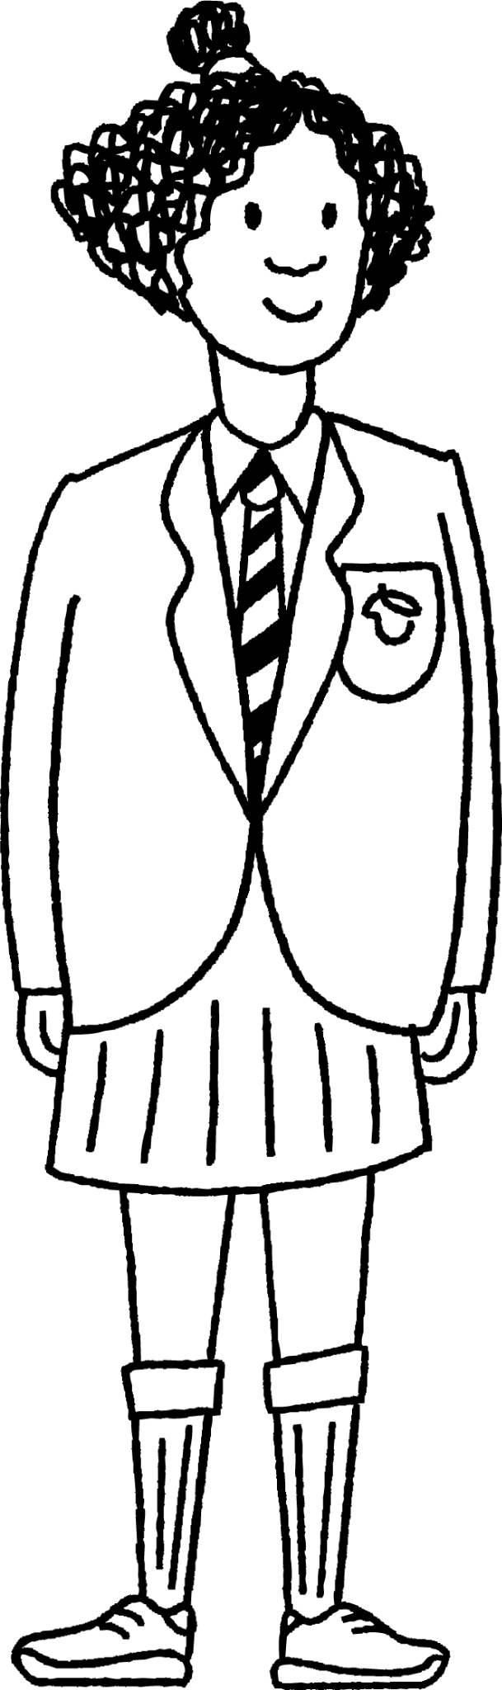

What is the range?
On a school trip, Izzy and Aisha get to try archery.
I got 3, 5, 5, 6, 4, 3, 5, 2, 5, 4 with my arrows.
I got 4, 2, 6, 6, 8, 10, 0, 0, 3, 5 with my arrows.
Who was more consistent?
Aisha was more consistent as her scores were less spread.

Slide 10
What is the range?
The range is a measure of how spread out, or dispersed, data is.
The range is calculated using the two extreme values in the data set; the lowest and the highest.
The dot plot range is indicated by the arrow.
It’s length is the difference between 29 and 12
The range is 17

Slide 11
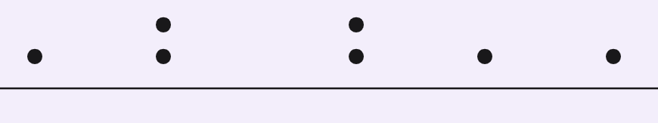
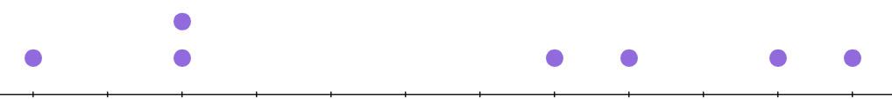
What is the range?
What is the range of this data?
What is the range of this data?
19
20
21
22
23
24
25
26
27
28
29
30
23
24
25
26
27
28
29
30
31
32
The extreme values are 19 and 30
The range is 30 − 19 = 11
The extreme values are 23 and 32
The range is 32 − 23 = 9

Slide 12
What is the range?
Here is a golf scorecard.
Hole | 1 | 2 | 3 | 4 | 5 | 6 | 7 | 8 | 9 | 10 | 11 | 12 | 13 | 14 | 15 | 16 | 17 | 18
Score (+/− par) | −1 | 0 | 0 | 0 | 1 | 1 | 0 | 0 | 0 | 0 | −2 | 0 | 0 | 1 | −1 | 0 | −1 | 2
The golfer scores from 2 under par to 2 over par. They have a range of 4 2 − (−2) = 4

Slide 13
What is the range?
The air temperature is recorded throughout an autumn day.
The range of the temperatures is 9°C.
The hottest temperature recorded was 16°C.
What was the coldest temperature recorded?
coldest
hottest
9°C
7 °C
? °C
16°C

Slide 14
What is the range?
Over the course of a month, the temperature is recorded at midday.
The lowest recorded temperature is −4°C and the range is 22°C.
What was the highest recorded temperature that month?
18°C

Slide 15
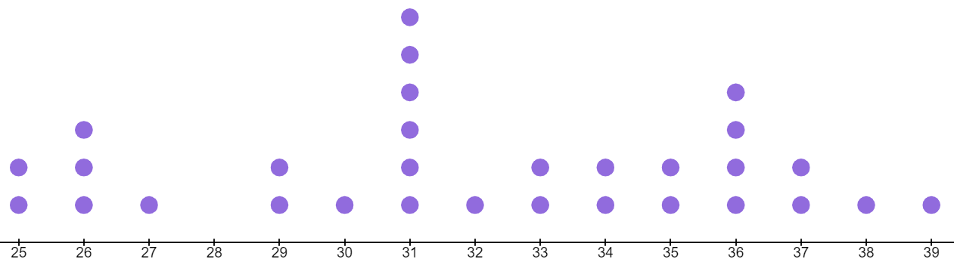
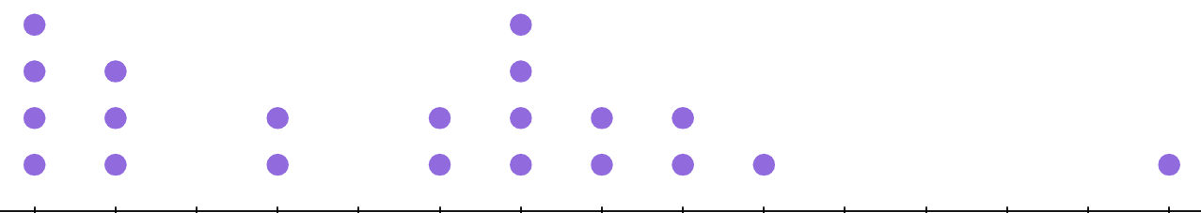
What is the range?
1) For each dot plot, work out the range.
a)
20
21
22
23
24
25
26
27
28
29
30
31
32
33
34
b)
58
59
60
61
62
63
64
65
66
67
68
69
70
71
72

Slide 16
What is the range?
2) For each set of data, work out the range.
a) -1, 0, 1, 1, 1, 2, 4, 5, 7, 7, 8, 8, 8, 10, 10, 10, 14, 17, 17, 20
b) -7, 6, 6, -3, -9, -9, -5, 6, -1, 6, 5, -6, -8, -4, -4, -3, 4, -6, 2, 6
c) 16.2, 15.3, 1.1, 19.4, 13.7, 6.7, 4.7, 12.1, 16.3, 9.4, 8.4, 18.2, 11.9, 1.6, 17.8

Slide 17

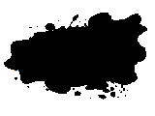
What is the range?
3)
Laura had just finished her homework on working out the range when her ink pen started to leak. What values has the ink spoiled?
a) Largest number is , smallest number is 14 so the range is 10
b) Largest number is 8, smallest number is so the range is 12
c) In order: −3, −1, −1, 0, , 6, 7, 10 so the range is 13
d) Any order: 3, 5, 3, 7, 10, 12, 6, 8, so the range is 11

Slide 18
What is the range?
1) For each dot plot, work out the range.
a)
range
= 34 - 20 = 14
20
21
22
23
24
25
26
27
28
29
30
31
32
33
34
b)
range
= 72 - 58 = 14
58
59
60
61
62
63
64
65
66
67
68
69
70
71
72

Slide 19
What is the range?
2) For each set of data, work out the range.
a) −1, 0, 1, 1, 1, 2, 4, 5, 7, 7, 8, 8, 8, 10, 10, 10, 14, 17, 17, 20
b) −7, 6, 6, −3, −9, −9, −5, 6, −1, 6, 5, −6, −8, −4, −4, −3, 4, −6, 2, 6
c) 16.2, 15.3, 1.1, 19.4, 13.7, 6.7, 4.7, 12.1, 16.3, 9.4, 8.4, 18.2, 11.9, 1.6, 17.8
range = 20 − (−1) = 21
range = 6 − (−9) = 15
range = 19.4 − 1.1 = 18.3

Slide 20
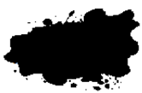
What is the range?
3)
Laura had just finished her homework on working out the range when her ink pen started to leak. What number has the ink spoiled in each case?
24
a) Largest number is , smallest number is 14 so the range is 10
b) Largest number is 8, smallest number is so the range is 12
-4
e.g. 2
Any number between 0 and 6
c) In order: -3, -1, -1, 0, , 6, 7, 10 so the range is 13
e.g. 1
1 or 14
d) Any order: 3, 5, 3, 7, 10, 12, 6, 8, so the range is 11

Slide 21
Understanding and calculating the range
What is the range?
Extreme values in different representations

Slide 22


Extreme values in different representations
The range does not consider any of the values within the data, only the two extreme values; the lowest and highest.
Is it necessary, when we have the averages: mean, mode and median?
They are measures of central tendency, whereas the range is a measure of spread.
Sofia
Jacob

Slide 23
Extreme values in different representations
These four data sets, all have a mean of 7.
1, 1, 1, 1, 1, 1, 43
a)
7, 7, 7, 7, 7, 7, 7
b)
What?! They feel really different to each other though!
Sofia
3.5, 4.8, 6.1, 6.9, 13.9, 17.4, 17.4
c)
4, 5, 6, 7, 8, 9, 10
d)
d
Jacob

Slide 24
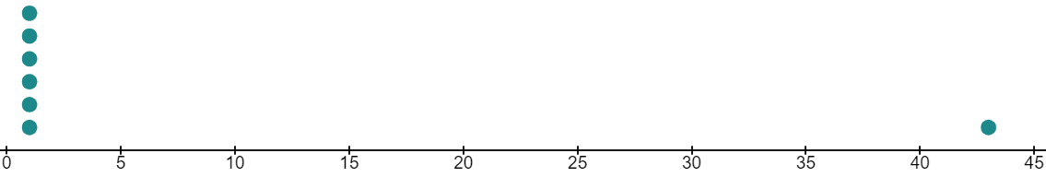
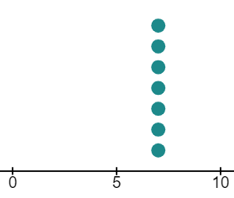
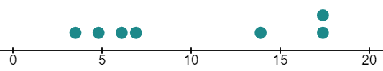

Extreme values in different representations
The four data sets shown as dot plots show the differences.
a)
range = 43 − 1 = 42
b)
c)
range = 17.4 − 3.5 = 13.9
d)
range = 7 − 7 = 0
range = 10 − 4 = 6

Slide 25
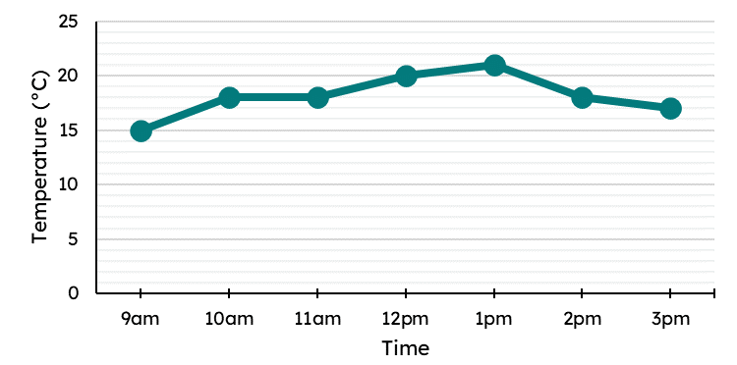

Extreme values in different representations
This line graph shows the classroom temperature over the course of day.
To calculate the range of temperature we need to identify the two extreme values.
They will be the highest point and the lowest point.
The range in temperature is 6°C.
Lucas

Slide 26
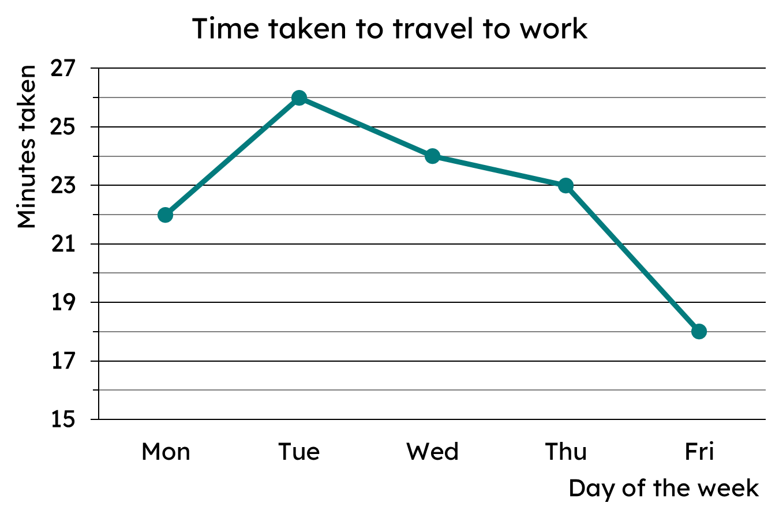
Extreme values in different representations
What is the range time taken to travel to work?
Longest time: 26 mins
Shortest time: 18 mins
Range
= 26 − 18
= 8 minutes

Slide 27
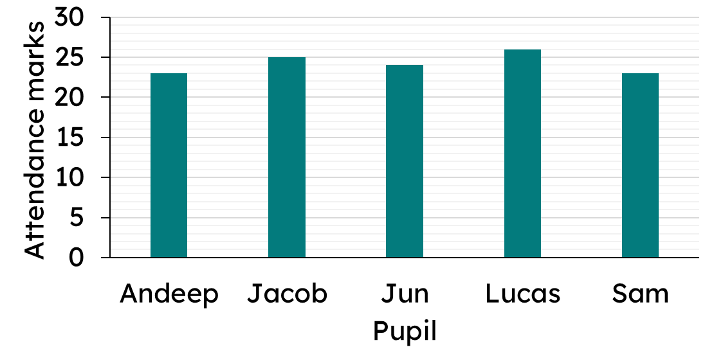
Extreme values in different representations
To find the range of attendance marks in these five pupils, we need to find the highest mark and the lowest mark.
Lucas: 26 marks
Sam/Andeep: 23 marks
Range in attendance marks
= 26 − 23 = 3 marks

Slide 28
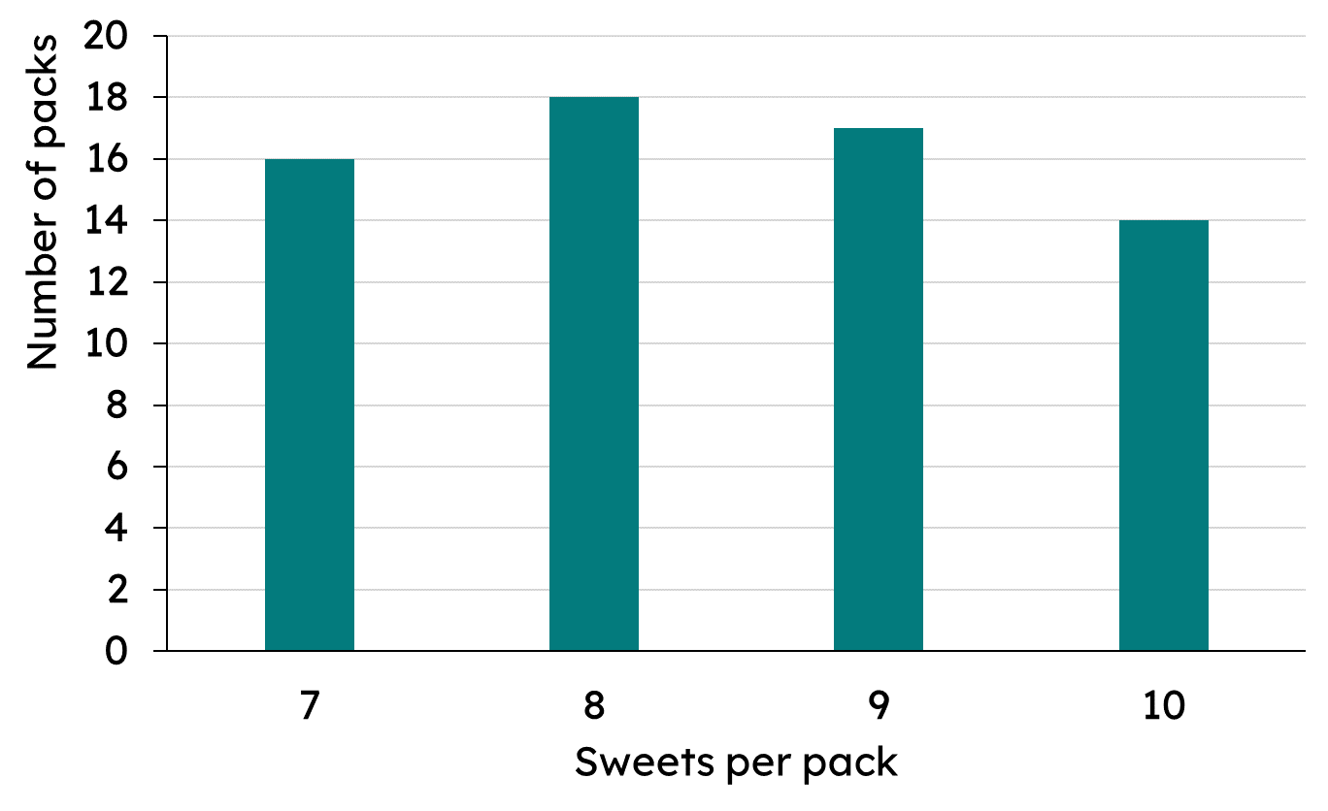
Extreme values in different representations
The frequency table and bar chart both show the same data.
sweets per pack | frequency
7 | 16
8 | 18
9 | 17
10 | 14
What are the extreme values?
The data is about the number of sweets per pack. The lowest amount is 7 and the highest amount is 10. So these are the extreme values.

Slide 29
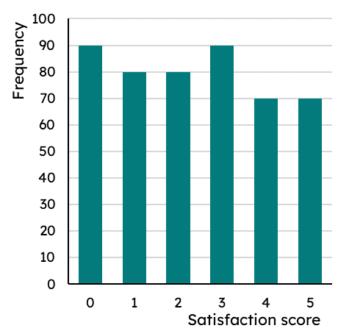
Extreme values in different representations
This bar chart shows the number of each satisfaction score a company received.
The scores received range between 5 and 0
The range of scores is therefore 5

Slide 30
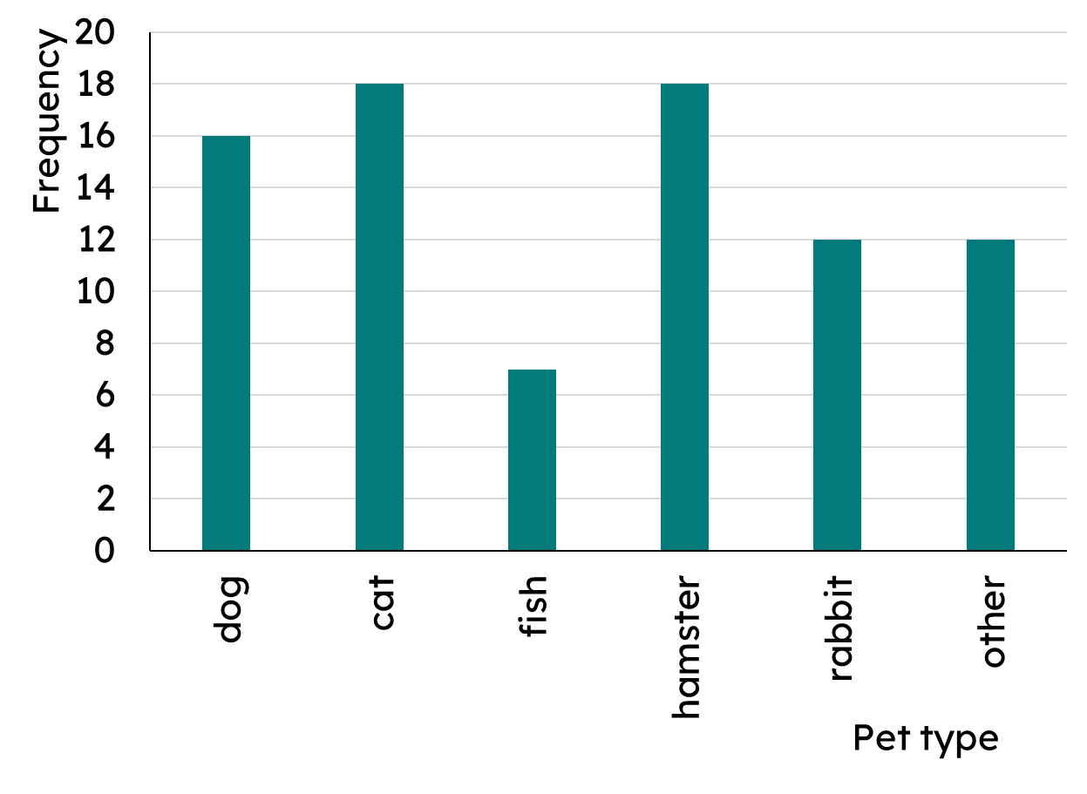

Extreme values in different representations
Data is collected about types of pets within a class. It is shown as a bar chart.
As the data is about pet type, I do not think there are ‘extreme’ values.
Is Andeep correct?
Andeep
Yes, there is no fixed order to this data. You cannot find the range.

Slide 31

Extreme values in different representations
The range can be found on all bar charts.
But, the method is different depending on the type of bar chart.
You cannot find the range of qualitative data.

Slide 32
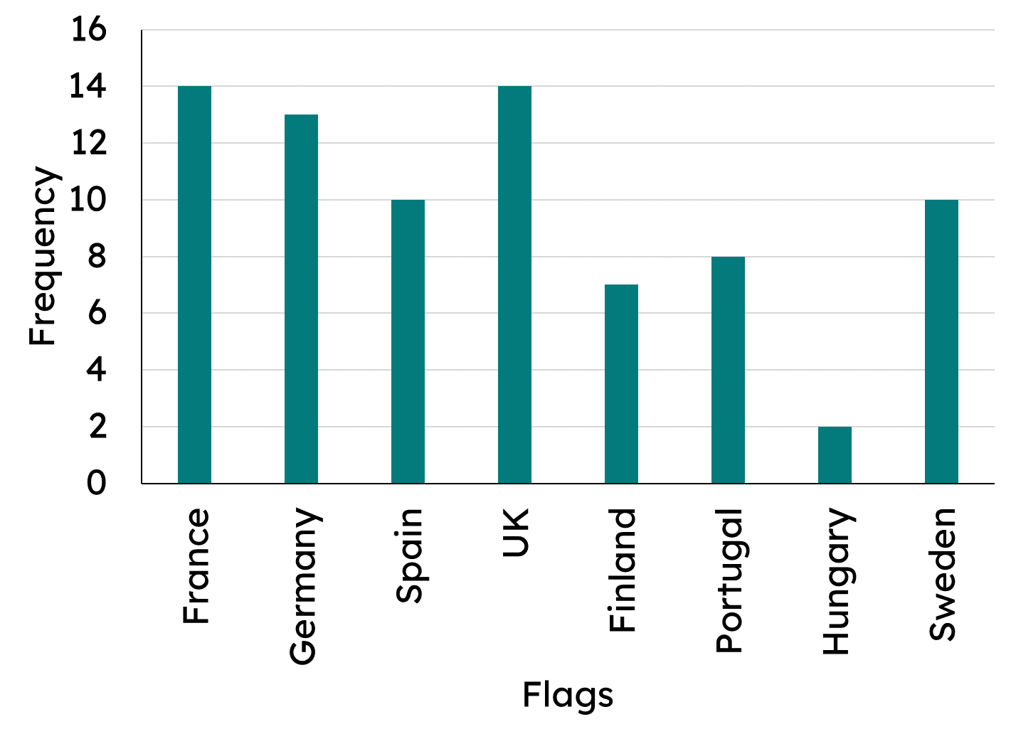
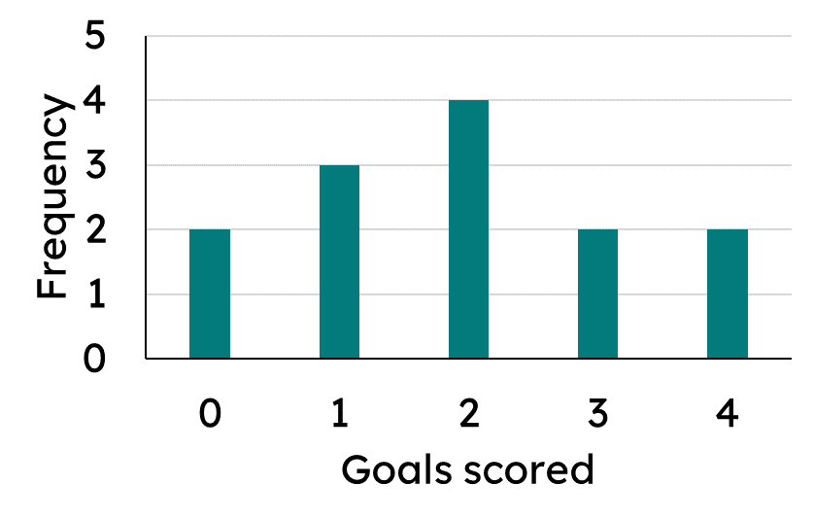
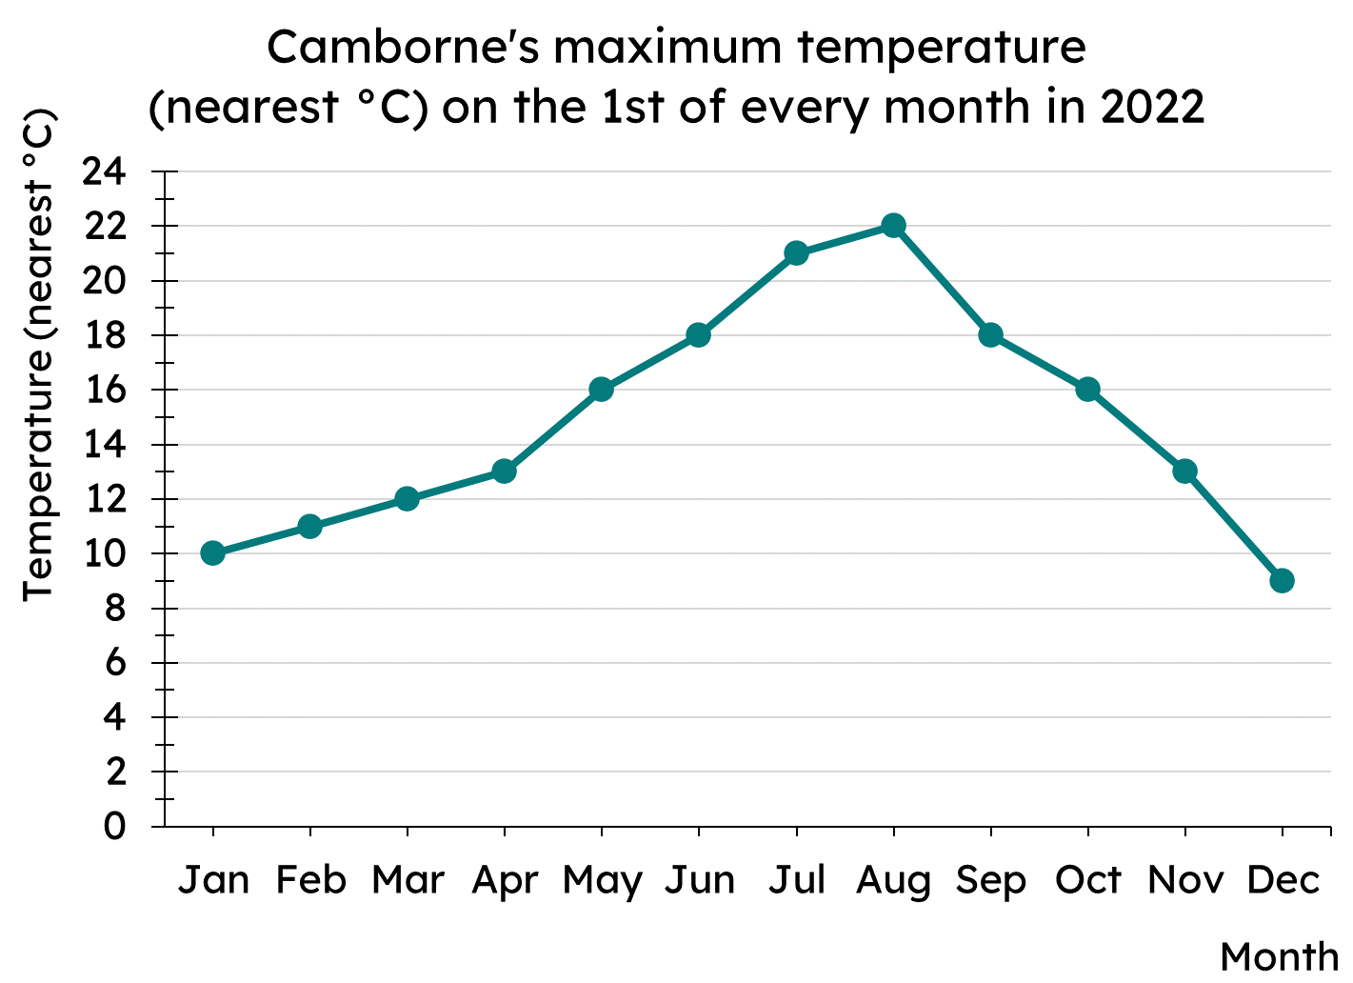
Extreme values in different representations
1) Which of these representations can you find the range?
a)
b)
c)
Shoe size | 3 | 4 | 5 | 6
Frequency | 7 | 12 | 10 | 3
d)

Slide 33
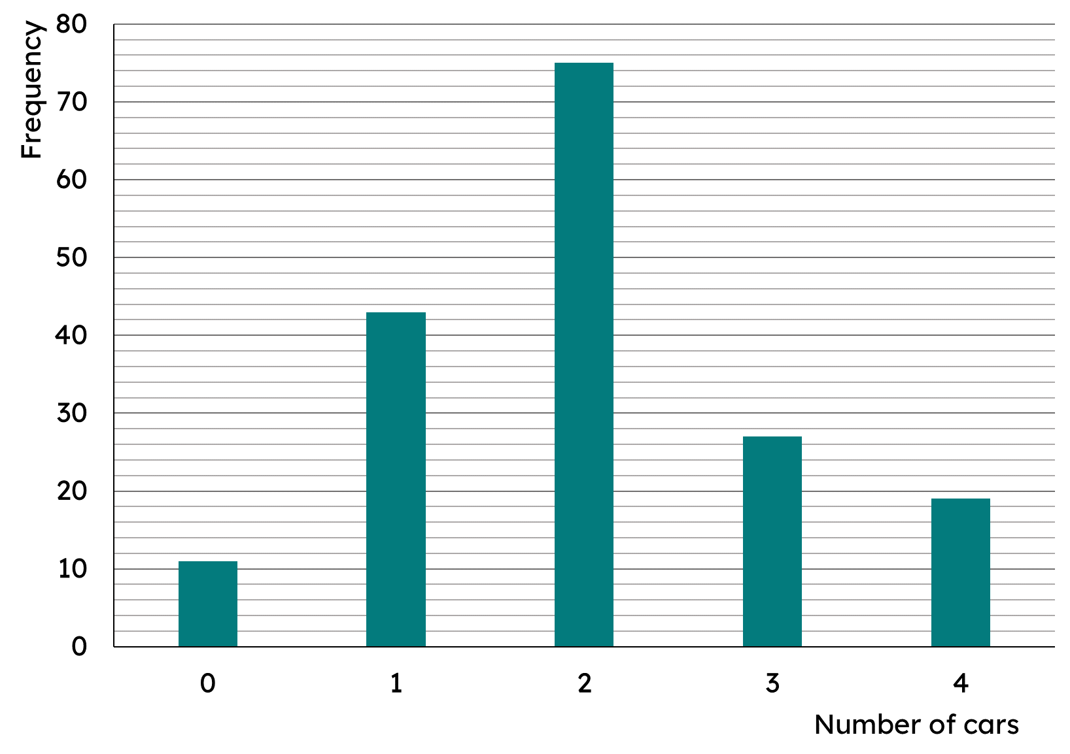
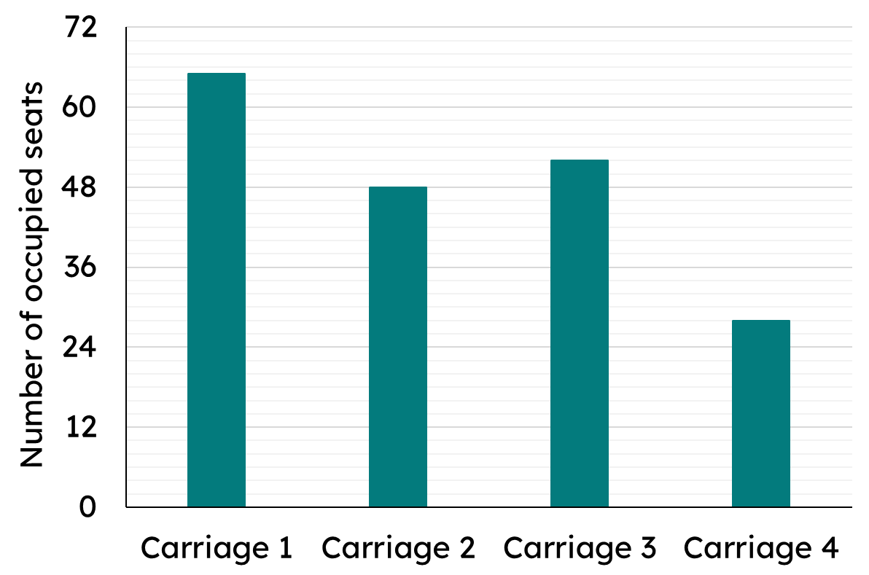
Extreme values in different representations
2) For each of the following bar charts, find the range.
a)
b)

Slide 34
Extreme values in different representations
3) Some data is represented in this frequency table about wait times at a fast food restaurant.
Wait time (mins) | 4 | 5 | 6 | 7 | 8 | 9 | 10 | 11
Frequency | 46 | 20 | 17 | 13 | 16 | 10 | 8 | 8
A local newspaper reported that customers’ wait time ranged by 38 minutes. Do you agree?

Slide 35

Extreme values in different representations
1) Which of these representations can you find the range?
a)
b)
c)
Shoe size | 3 | 4 | 5 | 6
Frequency | 7 | 12 | 10 | 3
d)

Slide 36
Extreme values in different representations
2) For each of the following bar charts, find the range.
a)
b)
Range of occupied seats: 65 − 28 = 37
Range of cars: 4 − 0 = 4

Slide 37
Extreme values in different representations
3) Some data is represented in this frequency table about wait times at a fast food restaurant.
Wait time (mins) | 4 | 5 | 6 | 7 | 8 | 9 | 10 | 11
Frequency | 46 | 20 | 17 | 13 | 16 | 10 | 8 | 8
A local newspaper reported that customers’ wait time ranged by 38 minutes. Do you agree?
No, the range of wait times is 7 mins; from the longest wait time of 11 minutes to the shortest wait time of 4 minutes.

Slide 38
Understanding and calculating the range
The range is the difference between the two extreme values.
The range is a measure of spread or dispersion. It allows you to see how varied the values in the data set are.
The type of diagram/chart will dictate where the range is found.

Slide 39

© Oak National Academy 2023.
Produced in partnership with Mathematics in Education and Industry.
Licensed on the Open Government Licence v3.0, except where otherwise stated. See Oak terms and conditions.

